Slide 1



Design of signal settings in Via Prenestina
Course of Traffic Engineering and ITS
STUDENTS:
Mohamed Shahid Affril Allaudeen 1924309
Sathiya Palani 1924018
GUIDE:
Professor Gaetano Fusco
Dott. Filippo Carrese

Slide 2
Overview
The Highway Capacity Manual defines the capacity as the maximum howdy rate at which persons or vehicle can be reasonably expected to traverse a point or a uniform segment of a lane or roadway during a given time period, under prevailing roadway, traffic and control conditions. Level-of-Service is introduced by HCM to denote the level of quality one can derive from a local under different operation characteristics and traffic volume.
HCM model is very useful for the analysis of signalized intersection as it considers all the adjustment factors which are to be taken into account while designing for a signalized I/S.

Slide 3
Methodology
Input Parameters
-Geometric
-Traffic
-Signal
Lane Grouping and Demand Flow Rate
-Lane grouping
-PHF
-RTOR
Saturation Flow Rate
-Basic equation
-Adjustment factors
Capacity and v/c
-Capacity
-v/c
Performance Measures
-Delay
-Progression Adjustment
-LoS
-Back of queue
A methodology for analysing the capacity and level of service (LOS) of signalized intersections is used.
The analysis considers a wide variety of prevailing conditions, including the amount and distribution of traffic movements, traffic composition, geometric characteristics, and details of intersection signalization.
The methodology focuses on the determination of LOS for known or projected conditions.
The capacity analysis methodology for signalized intersections is based on known or projected signalization plans.

Slide 4
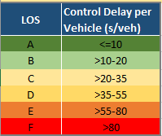
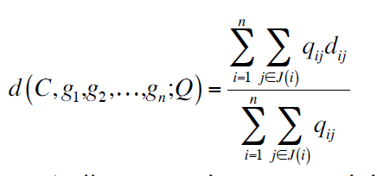
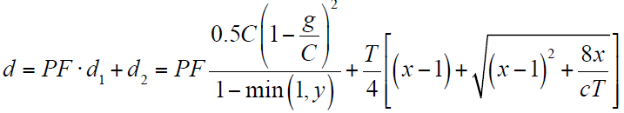
Objective
The primary output of the method is level of service (LOS)
To develop an optimize traffic signal cycle for signalized intersections
Objective function - Intersection average delay
where dij : Delay at each lane group j of each phase I
given by -
qij : corresponding traffic flows

Slide 5
Attributes
Peak Hour Factor, PHF adjusts volume to match peak 15 minutes
Design Hour Volume, vp is the one hour traffic volume used as the basis of design
DHV = (Peak-Hour Volume / PHF)
Lane Group, set of movements that has same green phase and move together which can be one or more lanes
Heavy Vehicles, %HV = (Daily number of HV) / ADT
AT,
Incremental Delay factor, k = 0.5,
for pre-timed type of signal setting
Arrival Type
Arrival Type | Description
1 | Dense platoon- 80% arrived at start of red
2 | Moderately dense- 40-80% arrived during red
3 | Less than 40% (highly dispersed platoon)
4 | Moderately dense, 40-80% arrived during green
5 | Dense to moderately dense- 80% arrive at start of green
6 | Very dense platoons progressing over a no. of closed space I/S

Slide 6
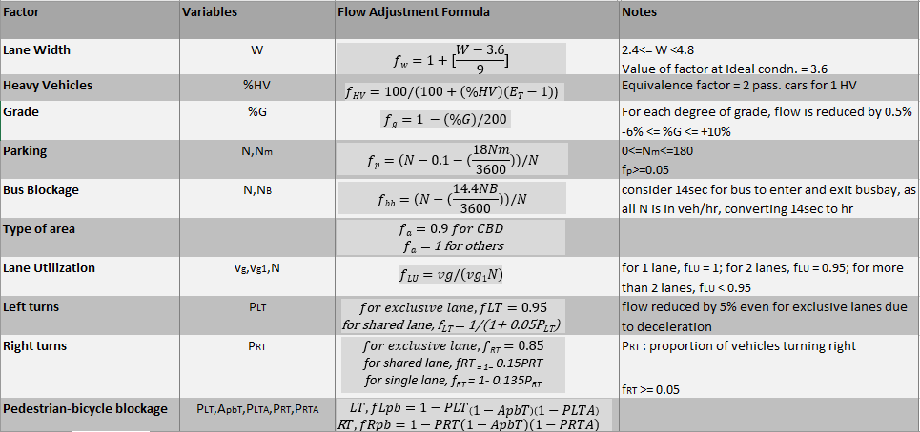
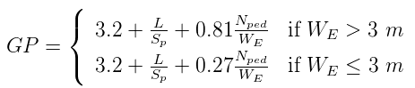
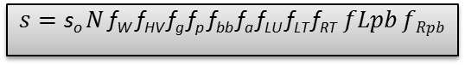
Attributes
Saturation Flow Rate, s (service rate) is maximum vehicles that can be served in 1 hour assuming continuous green and a continuous queue of vehicles
s_{i},
Pedestrian Green, GP
$$s=\text{s}\text{o} N \text{f}\text{W} \text{f}\text{HV} \text{f}\text{g} \text{f}\text{p} \text{f}\text{bb} \text{f}\text{a} \text{f}\text{LU} \text{f}\text{LT} \text{f}\text{RT} fLpb fRpb$$

Slide 7
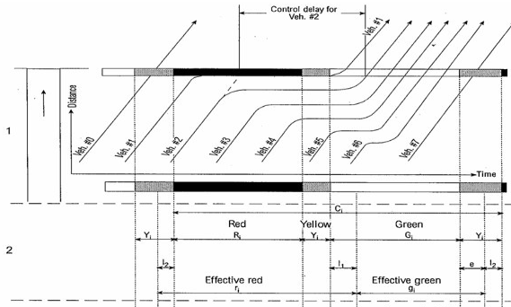
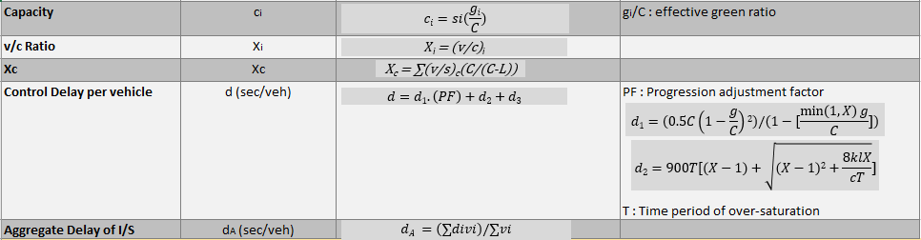
Attributes
Total Lost Time, L = l₁ + Y – e
Start-up Lost Time = l₁ = 2 sec (taken)
Clearance Lost Time = l₂ = 2 sec (taken)
Y = time period of yellow
e = effective extension of green time
r_{i} = C – g_{i} duration of effective red
Sum of effective green of all phases g₁+g₂ = C - L= ( Cycle length – L)

Slide 8
Considerations
T = 15 min
Single Analysis Period,
[ Assuming Demand Flow Rate across the study period equals to the flow rate as observed during the analysis period ]
T = 1 hour
Study Period,
Type of Signal Setting is Pre-timed
The value of PHF considered as -
PHF = 0.9 for heavy traffic approach
= 0.95 for light traffic approach
Base Saturation flow, so = 2100 (passenger cars per hour of green per lane)
There isn’t any area of Central Business district (CBD) characteristics, hence type of area is taken as “Others”
%Heavy Vehicles, %HV = (Daily number of HV) / ADT
Observed average flow of buses along the artery to be 4buses/hour
Considering Far-side and Near-side Bus Stops – bus stops immediately prior-to/after the intersection

Slide 9
Considerations
Proportion of vehicles arriving during green P for Arrival Type 3 is taken as 20% - 30%
Number of parking manoeuvres are observed between 5 – 30 per hour across the artery
Speed of pedestrians, Sp = 3.2 m/s and width of the crosswalk taken as 3.2m for few intersections which have WE > 3m
Incremental Delay factor, k = 0.5, for pre-timed type of signal setting
For most of the intersections analysed, start-up lost time and clearance lost time is considered equal to 3 seconds.

Slide 10
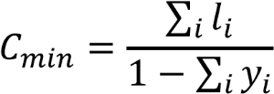
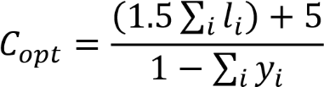
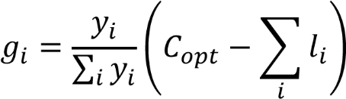
Minimum Cycle Length
Minimum Cycle Length,
The minimum cycle time need not be the optimum value
Minimum Effective Green,
𝑔_{𝑖} = 𝐶_{𝑚𝑖𝑛}𝑦𝑖
Webster Optimal Cycle Length
Webster Optimum Cycle Length,
The webster optimum cycle time is given by the empirical method
Effective Green,
Enumerative Method
The enumerative method is based on research of the minimum setting a finite domain within of which varying the variables of the problem and setting the step through which to pass from point to another one of set.
Enumerative method 1(C = constant)
Enumerative method 2 (g1/g2 = constant)

Slide 11
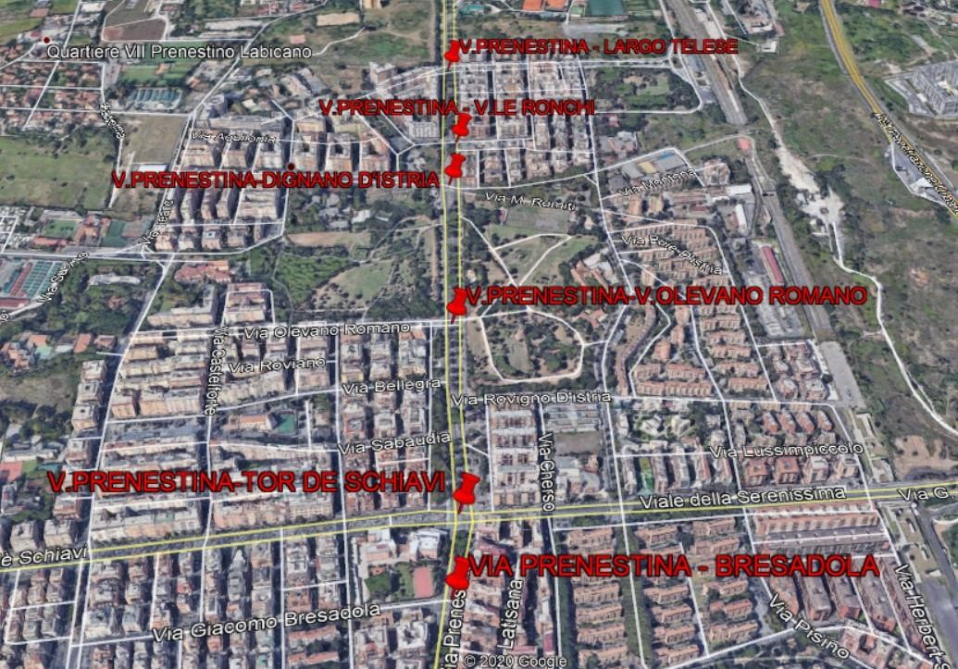
The Road Artery

Slide 12
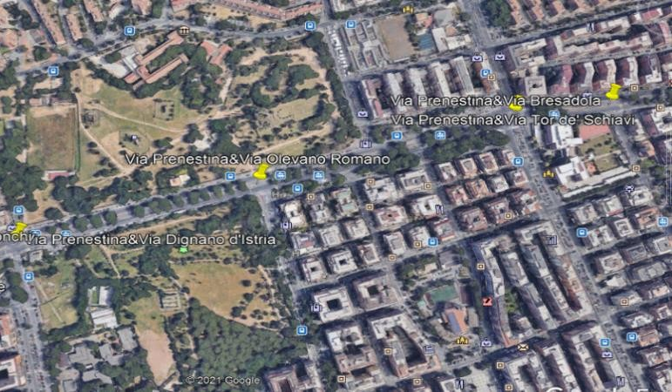
Intersections
The chosen signalised intersection were the following, and they are ordered by how they appear on the image to the right going from left to right
Via Prenestina – Largo Irpinia – Via Dignano d’Istra
Via Prenestina – Via Olevano Romano
Via Prenestina – Via Tor de Schiavi – Via della Serenissima
Via Prenestina – Via Bresadola

Slide 13
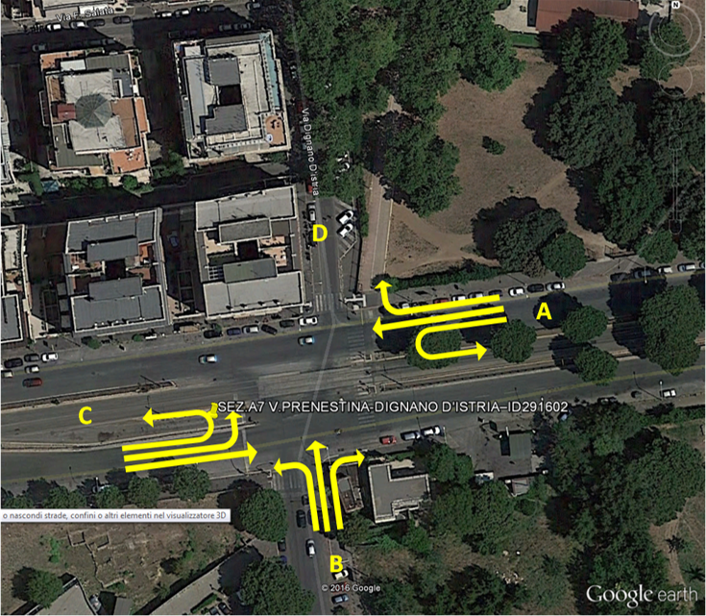
FIRST JUNCTION ANALYSIS: Via Prenestina – Largo Irpinia – Via Dignano d’Istra di Val Chisone
INTERSECTION DESCRIPTION:
A fourway intersection;
EB – WB : Via Prenestina
NB: Largo Irpinia
Via Dignano d’Istra is a oneway road and only recieves flow. So no vehicles are southbound.
A tramway line runs along the middle of Via Prenestina but has no inteference on the vehicular traffic.
Bus stops are present near the intersection, but are deemed to cause no blockage.
GEOMETRY OF THE ROADS:
DIRECTION | STREET NAME | NUMBER OF LANES | LANE WIDTH (m)
EB | Via Prenestina | 2 | 3.5
WB | Via Prenestina | 2 | 3.5
NB | Largo Irpinia | 3 | 3

Slide 14
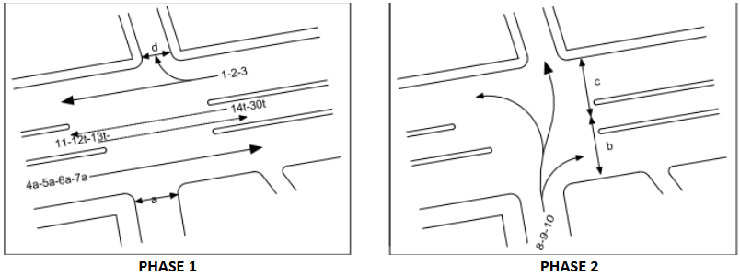
FIRST JUNCTION ANALYSIS: Via Prenestina – Largo Irpinia – Via Dignano d’Istra di
SIGNAL PHASE DIAGRAM AND SIGNAL TIMINGS:
PHASE | G (s) | Y (s) | R (s)
1 | 76 | 4 | 52
2 | 44 | 4 | 84
C= 132
Supplemental worksheets for pedestrian & bicycle effects on permitted right turns were needed, for both the WB
right turn and for the NB right turn

Slide 15
FIRST JUNCTION ANALYSIS: Via Prenestina – Largo Irpinia – Via Dignano d’Istra Via di Val Chisone
VOLUME ADJUSTMENT AND SATURATION FLOW RATE:
Analysis Period: Interval (18:00 – 19:00 )
TRAFFIC FLOW DATA
SATURATION FLOW RATE`
FLOW | LT | TH | RT
EB | 0 | 1370 | 0
WB | 0 | 1018 | 99
NB | 139 | 265 | 123
Saturation Flow | LT | TH | RT
EB | 0 | 3945.67
WB | 0 | 3944.54
NB | 5844.05
The main road Via Prenestina has the highest traffic volume especially from the EB approach. While the lowest belongs to the NB approach.
Even though WB has the highest traffic flow it has the lowest adjusted saturation flow rate. In fact, the highest and lowest amounts are flipped from the traffic flow data.

Slide 16
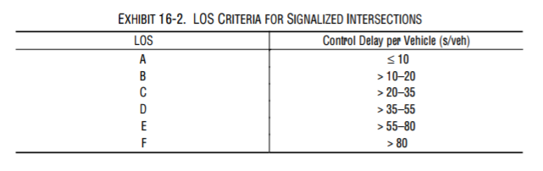
FIRST JUNCTION ANALYSIS: Via Prenestina – Largo Irpinia – Via Dignano d’Istra Via Via di Val Chisone
DELAYS AND LEVEL OF SERVICE:
The largest delay of the signalised intersection occurs on the NB approach and with a LOS of C.
The average delay of the intersection bringing the LOS to a C.
Approach | Road | Delay | LOS
EB | Via Prenestina | 22.52 | C
WB | Via Prenestina | 19.63 | C
NB | Largo Irpinia | 34.54 | C
Intersection Delay |  | 23.55 | C

Slide 17
FIRST JUNCTION ANALYSIS: Via Prenestina – Largo Irpinia – Via Dignano d’Istra
OPTIMISATION:
The current estimations has a LOS equivalent to C.
In this junction the minimum cycle method actually increased delay from the current estimations.
The signal optimisation’s and the Webster’s optimum has the former’s delay being marginally smaller.
Both also try to minimize the delay on the NB approach the most, which is also the most trafficked.
Optimisation | Current Estimations | Minimum Cycle | Webster’s Optimum | Signal optimisation
Cycle (s) | 132 | 23.4 | 44.8 | 44.4
g1 (s) | 76 | 9 | 26 | 25.9
g2 (s) | 44 | 2.3 | 6.8 | 6.5
g1/g2 | 1.73 | 3.91 | 3.82 | 3.98
Delay EB | 22.52 | 30.2 | 7.9 | 7.8
Delay WB | 19.63 | 11.4 | 6.7 | 6.5
Delay NB | 34.54 | 47.7 | 21.9 | 22.1
Intersection Delay | 23.55 | 26.30 | 10 | 9.89
LOS | C | C | B | A

Slide 18
FIRST JUNCTION ANALYSIS: Via Prenestina – Largo Irpinia – Via Dignano d’Istra
FIRST ITERATION:
Cycle | Delay
23.37 | 26.295
27.37 | 13.553
31.37 | 11.129
35.37 | 10.446
38.37 | 10.044
40.37 | 9.956
41.37 | 9.9303
42.37 | 9.9145
43.37 | 9.9074
44.37 | 9.9077
47.37 | 9.9455

Slide 19
FIRST JUNCTION ANALYSIS: Via Prenestina – Largo Irpinia – Via Dignano d’Istra
SECOND ITERATION:
g1/g2 | Delay
0.92 | 45.102
1.5 | 15.4833
1.9 | 12.7411
2.5 | 11.0569
2.9 | 10.4779
3.7 | 9.93782
3.8 | 9.91452
3.9 | 9.90051
3.99 | 9.89597
4 | 9.8959
4.01 | 9.8960
4.06 | 9.89785

Slide 20
FIRST JUNCTION ANALYSIS: Via Prenestina – Largo Irpinia – Via Dignano d’Istra
THIRD ITERATION:
Cycle | Delay
23.37 | 26.889
26.37 | 15.2887
28.37 | 12.8759
30.37 | 11.644
33.37 | 10.695
37.37 | 10.136
40.37 | 9.9596
43.37 | 9.8959
44.37 | 9.8921
45.37 | 9.8953
50.37 | 9.9907

Slide 21
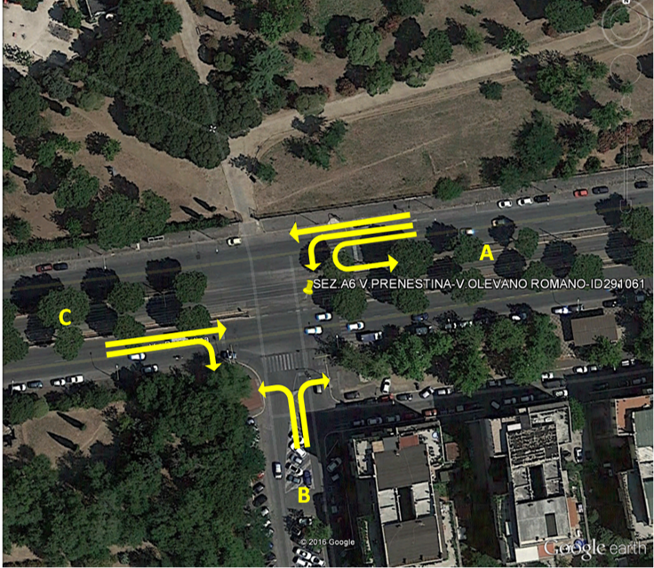
SECOND JUNCTION ANALYSIS: Via Prenestina –Via Olevano RomanoChisone
INTERSECTION DESCRIPTION:
A T-shaped intersection;
EB – WB : Via Prenestina
NB: Via Olevano Romano
The tramway is still present along the middle of Via Prenestina and causes no interference.
There are bus stops on either side of Via Prenestina past the signalised intersection, but yet again are deemed to cause no blockage.
GEOMETRY OF THE ROADS:
DIRECTION | STREET NAME | NUMBER OF LANES | LANE WIDTH (m)
EB | Via Prenestina | 3 | 3.5 (or 2.75 for the RT)
WB | Via Prenestina | 2 | 3.5
NB | Via Olevano Romano | 2 | 3

Slide 22
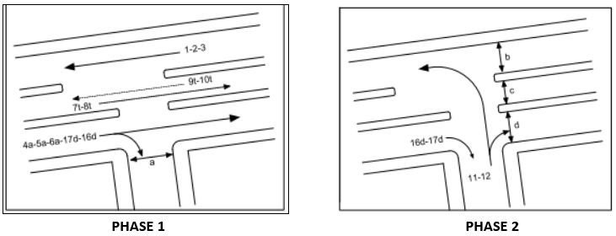
SECOND JUNCTION ANALYSIS: Via Prenestina –Via Olevano RomanoChisone di
SIGNAL PHASE DIAGRAM AND SIGNAL TIMINGS:
PHASE | G (s) | Y (s) | R (s)
1 | 75 | 4 | 49
2 | 45 | 4 | 79
C= 128
The EB right turn is green in both phases and is always permitted.
Supplemental worksheets for pedestrian & bicycle effects on permitted right turns were needed, for both the EB
right turn and for the NB right turn.

Slide 23
SECOND JUNCTION ANALYSIS: Via Prenestina –Via Olevano RomanoChisone Via di Val Chisone
VOLUME ADJUSTMENT AND SATURATION FLOW RATE:
Analysis Period: evening interval (18:00 – 19:00 )
TRAFFIC FLOW DATA
SATURATION FLOW RATE
FLOW | TH | LT | RT
EB | 1184 | 0 | 310
WB | 950 | 0 | 0
NB | 0 | 164 | 61
SATURATION FLOW | TH | LT | RT
EB | 3944.8 | 0 | 1796.97
WB | 3944.93 | 0 | 0
NB | 0 | 3663.43
Again, Via Prenestina contains the greatest traffic counts with the EB approach being the most trafficked this time around. The lowest still belongs to the NB approach.
The adjusted saturation flow rate match the same order of largest to smallest if considering the combined saturation flow rate of the approach. Looking at the lane groups individually this is not the case. Both EB groups have a smaller saturation flow rate than comparable movements from the other approaches.

Slide 24
SECOND JUNCTION ANALYSIS: Via Prenestina –Via Olevano RomanoChisone
DELAYS AND LEVEL OF SERVICE:
Approach | Road | Delay | LOS
EB | Via Prenestina | 18.85 | B
WB | Via Prenestina | 16.84 | B
NB | Via Olevano Romano | 30.66 | C
Intersection Delay |  | 18.74 | B
The highest delay between the approaches is the NB one. It is the only one with a LOS of C with the other two approaches both having a LOS of B.
With Via Prenestina having a much larger traffic count than Via Olevano Romano it is not surprising that the overall average delay of the intersection is within one or two seconds of the delays from the main road and over thirteen seconds fewer than the one experienced by vehicles in the minor road.

Slide 25
SECOND JUNCTION ANALYSIS: Via Prenestina –Via Olevano RomanoChisone
OPTIMISATION:
In this junction the minimum cycle method actually increased delay from the current estimations. The LOS is C while for the current estimations was a B.
Again Webster’s Optimum and the Signal optimisation had the smallest delays, both boasting a LOS of A.
While they had the same LOS. The Signal optimisation delay was shorter by a second.
Something consistent across all of them was that the vehicles from the NB direction experienced the most delay. The more travelled, Via Prenestina, was favoured over the lesser travelled, Via Olevano Romano.
Optimisation | Current Estimations | Minimum Cycle | Webster’s Optimum | Signal optimisation
Cycle (s) | 128 | 20.1 | 38.5 | 52.1
g1 (s) | 75 | 6.7 | 22 | 34.3
g2 (s) | 45 | 1.4 | 4.5 | 5.7
g1/g2 | 1.67 | 4.79 | 4.89 | 6.02
Delay EB | 18.85 | 31.5 | 6.4 | 5.2
Delay WB | 16.84 | 11.3 | 5.5 | 4.6
Delay NB | 30.66 | 66.2 | 21.8 | 29.2
Intersection Delay | 18.74 | 24.70 | 7 | 6.93
LOS | B | C | A | A

Slide 26
SECOND JUNCTION ANALYSIS: Via Prenestina –Via Olevano RomanoChisone
FIRST ITERATION:
Cycle | Delay
25.07 | 9.879
30.07 | 8.101
35.07 | 7.482
40.07 | 7.221
47.07 | 7.839
48.07 | 7.836
49.07 | 7.837
55.07 | 7.9

Slide 27
SECOND JUNCTION ANALYSIS: Via Prenestina –Via Olevano RomanoChisone
SECOND ITERATION:
g1/g2 | Delay
4.0 | 7.5.72
5.0 | 7.0790
5.5 | 6.9817
5.6 | 6.9704
5.7 | 6.9618
5.8 | 6.9560
5.9 | 6.9528
5.97 | 6.9522
5.98 | 6.9522
5.99 | 6.9523
6.15 | 6.9568

Slide 28
SECOND JUNCTION ANALYSIS: Via Prenestina –Via Olevano RomanoChisone
THIRD ITERATION:
Cycle | Delay
20.07 | 26.683
25.07 | 11.088
30.07 | 8.4788
35.07 | 7.5797
40.07 | 7.1817
45.07 | 7.001
51.07 | 6.9339
52.07 | 6.9332
53.07 | 6.9349
60.07 | 6.9996
64.07 | 7.0681

Slide 29
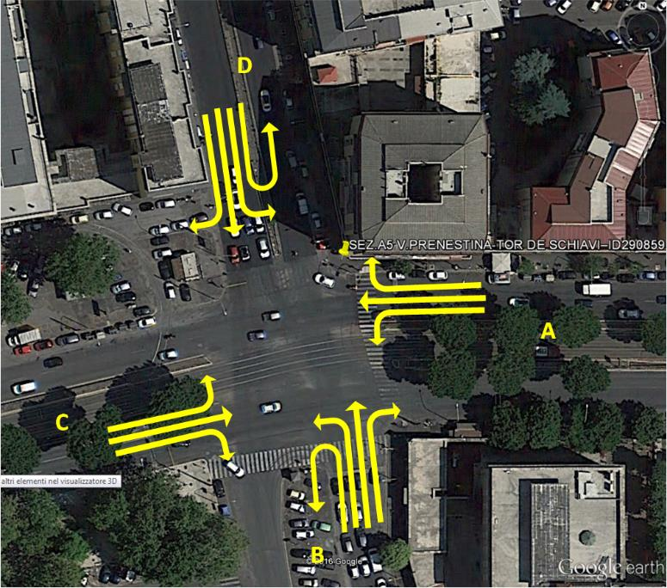
THIRD JUNCTION ANALYSIS: VIA PRENESTINA – VIA TOR DE’ SCHIAVI – VIA DELLA SERENISSIMA
INTERSECTION DESCRIPTION:
4 legs junction;
EB – WB : Via Prenestina
NB: Via Tor De’ Schiavi
SB: Via Della Serenissima
Tramway line which divide the opposing traffic flows in Via Prenestina; no interaction between trams and other vehicles;
Traffic islands which divide the opposing traffic flows in Via Tor De’ Schiavi and in Via Della Serenissima;
GEOMETRY OF THE ROADS:
DIRECTION | STREET NAME | NUMBER OF LANES | LANE WIDTH (m)
EB | Via Prenestina | 3 | 3.5
WB | Via Prenestina | 3 | 3.5
NB | Via Tor de’ Schiavi | 3 | 3.5
SB | Via della Serenissima | 3 | 3.5

Slide 30
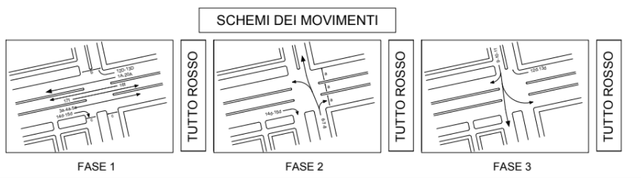
THIRD JUNCTION ANALYSIS: VIA PRENESTINA – VIA TOR DE’ SCHIAVI – VIA DELLA SERENISSIMA Via di Val Chisone
INPUT DATA AND SIGNAL PHASE DIAGRAM:
PHASE | G (s) | Y (s) | R (s)
1 | 48 | 4 | 80
2 | 42 | 4 | 86
3 | 36 | 4 | 92
C= 132
Any possibility to have left turning manoeuvres for East Bound and West Bound traffic flows.
Permitted rigth turns in East Bound, West Bound (phase 1) and North Bound (phase 2).

Slide 31

THIRD JUNCTION ANALYSIS: VIA PRENESTINA – VIA TOR DE’ SCHIAVI – VIA DELLA SERENISSIMA Via di Val Chisone
VOLUME ADJUSTMENT AND SATURATION FLOW RATE:
PEAK HOUR INTERVAL: Evening interval (18:00 – 19:00 )
TRAFFIC FLOW DATA:
FLOW | LT | TH | RT
EB | 0 | 810 | 85
WB | 0 | 556 | 211
SB | 175 | 616 | 99
NB | 398 | 609 | 60
Organization in lane groups considering:
-Exclusive turning lanes as a single lane group;
-Number of turning vehicles w.r.t. through traffic flow;
SATURATION FLOW RATE:
SATURATION FLOW | LT | TH | RT
EB | 3498 |  | 1538.07
WB | 3545 |  | 1577.12
SB | 1633.18 | 3138.77
NB | 3763 |  | 1505.76
The highest values of saturation flows are relative to the approaches of the main road, EB and WB.

Slide 32
THIRD JUNCTION ANALYSIS: VIA PRENESTINA – VIA TOR DE’ SCHIAVI – VIA DELLA SERENISSIMA Via di Val Chisone
DELAYS AND LEVEL OF SERVICE:
Very low Level of Service of the junction with high delay both for every single approach and for the whole intersection.
The approach with highest delay, and so lowest LOS, is Tor De’ Schiavi ( North Bound directions); it is intuitive to think that this is due to the low value of the green time combined with a v/c ratio not low enough to guarantee good conditions.
DELAY | VIA | DELAY | LOS
EB | Prenestina | 38.74 | D
WB | Prenestina | 34.62 | C
SB | Serenissima | 69.12 | E
NB | Tor De’ Schiavi | 73.33 | E
INTERSECTION DELAY |  | 55.57 | E

Slide 33
THIRD JUNCTION ANALYSIS: VIA PRENESTINA – VIA TOR DE’ SCHIAVI – VIA DELLA SERENISSIMA Via di Val Chisone
OPTIMISATION:
The current situation presents a low LOS equal to E, which is going to be improved through the optimisation process.
The minimum cycle and Webster’s optimum provide a lower delay and so an increased LOS equal to D.
The best configuration is obtained by the Signal optimisation process, which result is LOS equal to C.
Optimisation | Current Estimations | Minimum Cycle | Webster’s Optimum | Signal optimisation
Cycle (s) | 132 | 55.4 | 106.1 | 105.4
g1 (s) | 48 | 12.9 | 27.9 | 49.5
g2 (s) | 42 | 16.5 | 35.8 | 43.8
g3 (s) | 36 | 14 | 30.4 | 30.4
g1/g2 | 1.14 | 0.782 | 0.779 | 1.130
Delay EB | 38.74 | 48.2 | 46.99 | 19.8
Delay WB | 34.62 | 24.6 | 37.507 | 18.2
Delay NB | 73.33 | 44.6 | 41.35 | 27.9
Delay SB | 69.12 | 46.4 | 45.43 | 44.5
Intersection Delay | 55.57 | 41.68 | 43 | 27.93
LOS | E | D | D | C

Slide 34
THIRD JUNCTION ANALYSIS: VIA PRENESTINA – VIA TOR DE’ SCHIAVI – VIA DELLA SERENISSIMA Via di Val Chisone
FIRST ITERATION:
Cycle | Delay
75.36 | 82.964
80.36 | 65.1732
83.36 | 57.5963
85.36 | 53.6289
87.36 | 50.4450
90.36 | 46.9703
100.36 | 42.5615
101.36 | 42.5252
102.36 | 42.5357
107.36 | 43.1779
124.36 | 51.0978

Slide 35
THIRD JUNCTION ANALYSIS: VIA PRENESTINA – VIA TOR DE’ SCHIAVI – VIA DELLA SERENISSIMA Via di Val Chisone
SECOND ITERATION:
g1/g2 | Delay
0.45 | 71.929
0.50 | 62.366
0.55 | 55.226
0.6 | 49.974
0.65 | 46.362
0.70 | 44.084
0.75 | 42.866
0.80 | 42.436
0.81 | 42.425
0.82 | 42.438
0.95 | 44.458

Slide 36
THIRD JUNCTION ANALYSIS: VIA PRENESTINA – VIA TOR DE’ SCHIAVI – VIA DELLA SERENISSIMA Via di Val Chisone
THIRD ITERATION:
Cycle | Delay
75.36 | 82.722
80.36 | 65.061
85.36 | 53.600
89.36 | 47.934
93.36 | 44.601
95.36 | 43.588
100.36 | 42.468
101.36 | 42.425
102.36 | 42.430
107.36 | 43.054
115.36 | 45.760

Slide 37
THIRD JUNCTION ANALYSIS: VIA PRENESTINA – VIA TOR DE’ SCHIAVI – VIA DELLA SERENISSIMA Via di Val Chisone
FOURTH ITERATION:
g1/g2 | Delay
0.4 | 34.8730
0.5 | 31.4176
0.6 | 29.9745
0.7 | 29.1213
0.8 | 28.5731
0.9 | 28.2238
1.0 | 28.0208
1.12 | 27.9312
1.13 | 27.9305
1.14 | 27.9309
1.30 | 28.0729

Slide 38
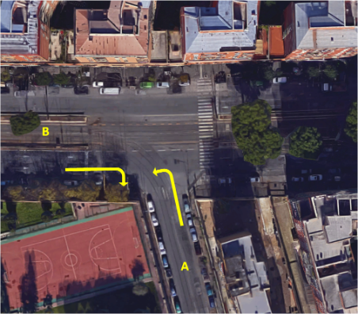
FOURTH JUNCTION ANALYSIS: VIA PRENESTINA – VIA GIACOMO BRESADOLA di Val Chisone
INTERSECTION DESCRIPTION:
A T-shaped junction;
EB – WB : Via Prenestina
NB: Via Giacomo Bresadola
Tramway line which divide the opposing traffic flows in Via Prenestina; no interactions between trams and other vehicles
GEOMETRY OF THE ROADS:
DIRECTION | STREET NAME | NUMBER OF LANES | LANE WIDTH (m)
EB | Via Prenestina | 2 | 3.5
WB | Via Prenestina | 2 | 3.5
NB | Via Giacomo Bresadola | 1 | 3.5

Slide 39
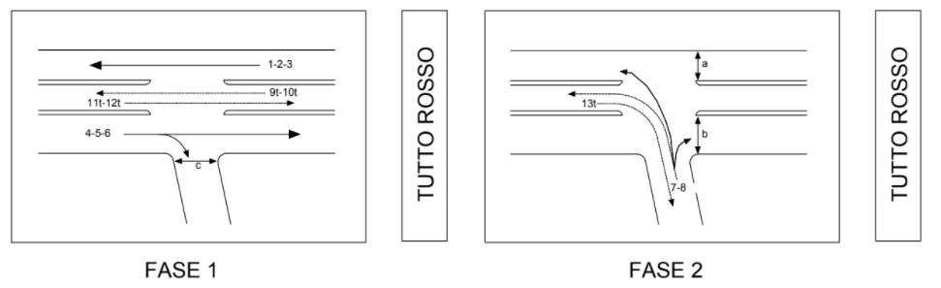
FOURTH JUNCTION ANALYSIS: VIA PRENESTINA – VIA GIACOMO BRESADOLA Via di Val Chisone
INPUT DATA AND SIGNAL PHASE DIAGRAM:
PHASE | G (s) | Y (s) | R (s)
1 | 76 | 4 | 52
2 | 44 | 4 | 84
C= 132
Any possibility to have left turning manoeuvres for East Bound and West Bound traffic flows.
Permitted rigth turns in East Bound and North Bound.

Slide 40
FOURTH JUNCTION ANALYSIS: VIA PRENESTINA – VIA GIACOMO BRESADOLA Via di Val Chisone
VOLUME ADJUSTMENT AND SATURATION FLOW RATE:
PEAK HOUR INTERVAL: Morning time interval (18:00 – 19:00)
TRAFFIC FLOW DATA:
The detected data are relating only to the East Bound right turns (from Via Prenestina to Via Bresadola) and to North Bound left turns (from Via Bresadola to Via Prenestina).
FLOW | LT | TH | RT
NB | 80 | 0 | 0
EB | 0 | 0 | 310
WB | 0 | 0 | 0
The highest traffic flow has been detected in the East Bound approach, while the lower in the North Bound ones;
The saturation flows are consistent with these data.
SATURATION FLOW RATE:
SATURATION FLOW | LT | TH | RT
NB | 1780 | 0 | 0
EB | 0 | 0 | 1474.47

Slide 41
FOURTH JUNCTION ANALYSIS: VIA PRENESTINA – VIA GIACOMO BRESADOLA Via di Val Chisone
DELAYS AND LEVEL OF SERVICE:
Important difference in the LOS of the two approaches due to the difference in the relation between flows and green times of the two roads;
The highest delay between the approaches is the NB one, which generates a LOS of type C. However, because of the lower delay resulted by the approach EB the whole junction has a LOS equal to C.
DELAY | VIA | DELAY | LOS
NB | Bresadola | 32.89 | C
EB | Prenestina | 18.17 | B
INTERSECTION DELAY |  | 21.19 | C

Slide 42
FOURTH JUNCTION ANALYSIS: VIA PRENESTINA – VIA GIACOMO BRESADOLA Via di Val Chisone
OPTIMISATION:
Optimisation | Current Estimations | Minimum Cycle | Webster’s Optimum | Signal optimisation
Cycle (s) | 132 | 16.749 | 32.102 | 39.7
g1 (s) | 76 | 3.91 | 16.56 | 22.5
g2 (s) | 44 | 0.836 | 3.54 | 5.3
g1/g2 | 1.7 | 4.68 | 4.68 | 4.25
Delay EB | 18.17 | 54.91 | 6.85 | 6.4
Delay NB | 32.89 | 103.42 | 20.74 | 20.2
Intersection Delay | 21.19 | 64.86 | 9.7 | 9.25
LOS | C | E | A | A
This time the current situation presents a LOS equal to C, which is going to be improved through the optimisation process.
The minimum cycle provides the higher delay equal to 64.86 second with a corresponding LOS of type E.
The delay obtained by Webster’s optimisation is lower (9.7 sec) but bigger than the one obtained by the Signal optimisation process, which result is LOS of type A.

Slide 43
FOURTH JUNCTION ANALYSIS: VIA PRENESTINA – VIA GIACOMO BRESADOLA Via di Val Chisone
FIRST ITERATION:
Cycle | Delay
103.42 | 64.86
23.60 | 11.85
20.95 | 10.06
21.24 | 9.33
21.41 | 9.31
21.60 | 9.30
21.81 | 9.29
22.03 | 9.30
22.26 | 9.31
22.50 | 9.32
22.75 | 9.34
23.00 | 9.36
23.27 | 9.39
23.54 | 9.42
24.67 | 9.57

Slide 44
FOURTH JUNCTION ANALYSIS: VIA PRENESTINA – VIA GIACOMO BRESADOLA Via di Val Chisone
SECOND ITERATION:
g1/g2 | Delay
0.1 | 981.28
0.5 | 50.76
0.85 | 18.62
1.5 | 12.23
2.5 | 9.99
3.5 | 9.35
4 | 9.26
4.05 | 9.25
4.1 | 9.25
4.15 | 9.25
4.2 | 9.25
4.25 | 9.25
4.3 | 9.25
4.35 | 9.26

Slide 45
FOURTH JUNCTION ANALYSIS: VIA PRENESTINA – VIA GIACOMO BRESADOLA Via di Val Chisone
THIRD ITERATION:
Cycle | Delay
80.81 | 64.23
32.43 | 19.26
23.06 | 13.10
19.40 | 10.34
19.20 | 9.44
19.82 | 9.27
20.02 | 9.26
20.23 | 9.25
20.45 | 9.25
20.68 | 9.26
20.93 | 9.27
22.25 | 9.41
23.39 | 9.57

Slide 46

SYNCHRONISATION
Synchronization is a method used in order to improve Level of Service of junction, looking for decrease delay.
The goal is to switch on the green light when the vehicles approach the intersection.
In the ideal condition no vehicle has to be stopped, avoiding the delay; but in the real situation the several nodes, which represent the junctions, are not at the same distance.
They can been considered two different types of synchronization:
• Ideal synchronization (only possible if the junctions had the same spacing A and the flow was under a certain value, without variations among the artery);
• Maximum Bandwidth Problem;

Slide 47
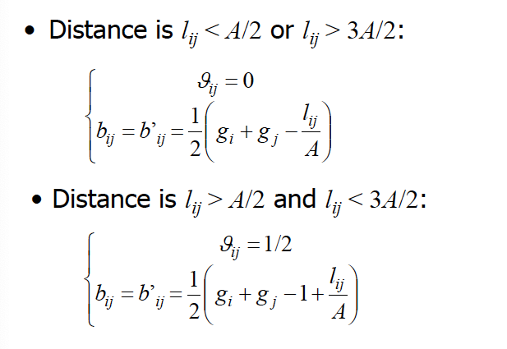
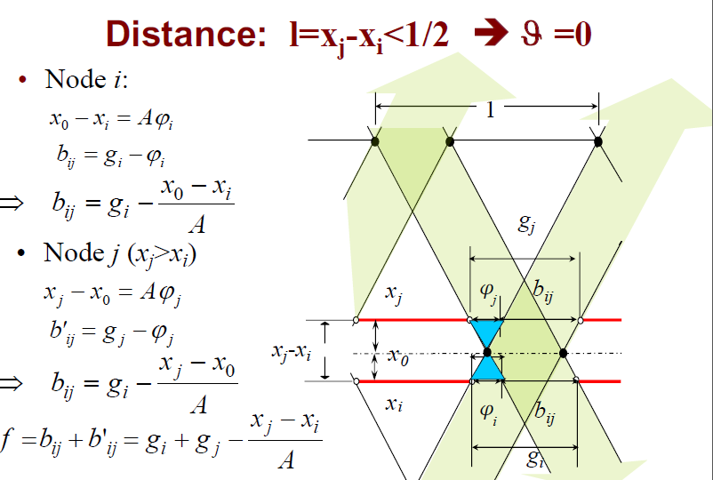
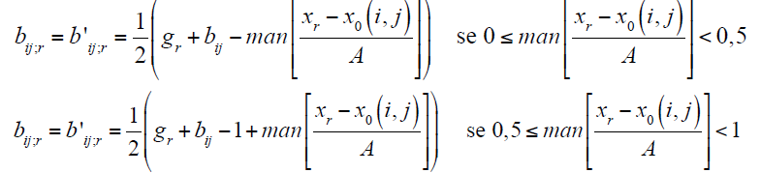
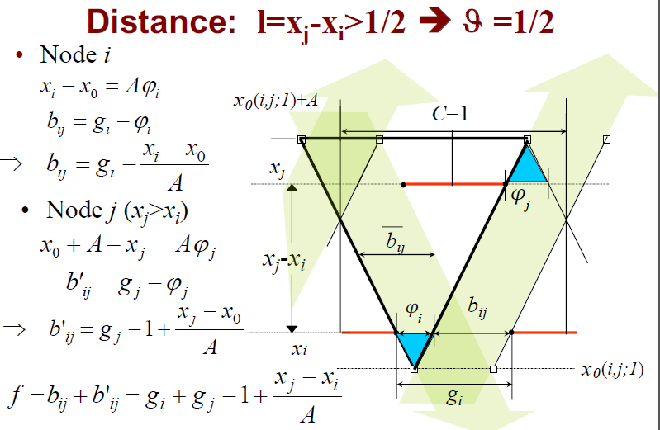
SYNCHRONISATION

Slide 48
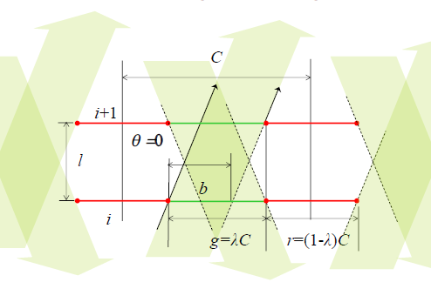
SYNCHRONISATION: MAXIMUM BANDWIDTH
Delay at junctions is the most relevant component of travel times in urban road networks;
Signal synchronization sets a relationship among green starts at near junctions with the aim of reducing or, if possible, make nil junction delay.
The synchronization problem with maximalbandwidth consists in:
Finding the vector of offset θ_{ij} that minimizes the delays of vehicles traveling along the artery;
Given:
– The distance between consecutive intersections: l_{i}
– The signal settings at each intersection: C, g_{i}
– The synchronization speed assuming that vehicles travel at that speed along the artery: v

Slide 49
SYNCHRONISATION: MAXIMUM BANDWIDTH
Artery: Via Prenestina;
Order of the intersections: from East Bound to West Bound;
Steps to follow
Coordinate first pair of signals
Individuate ideal System equivalent to the first pair
Coordinate a third signal with the ideal system
Individuate a new ideal system
Continue until all nodes are coordinated
A | 792
A/2 | 396
3A/2 | 1188
Junction | Distance from previous Point(m) | Progressive Distance(m) | Cycle Time(s) | Green Time(s) | g/C
1 | 0 | 0 | 132 | 76 | 0.58
2 | 330 | 330 | 128 | 75 | 0.59
3 | 344 | 674 | 132 | 48 | 0.36
4 | 138 | 812 | 132 | 76 | 0.58
C | 132 | s
v | 12 | m/s

Slide 50
Synchronization 1-2
Synchronization of pair of signal 1& 2
l12 | 330
Teta | 0
b12 | 0.3636
Xo12 (m) | 168
Synchronization 1-2-3
Synchronization 1-2-3-4
Synchronization of signal 3 with the ideal signal x0(1;2)
Uo3 | 0.63889
Mantissa | 0.63889
Teta | 0.5
b123 | 0.183
Xo3 (m) | 531
Synchronization of signal 4 with the ideal signal x1(1,2;3)
Uo4 | 0.3548
Mantissa | 0.3548
Teta | 0
b1234 | 0.20202
Xo4 (m) | 531

Slide 51
SYNCHRONISATION: MAXIMUM BANDWIDTH
First pair junction synchronisation:
Signals |  | Distance [m] | l₁₂<A/2 | ϴ | b₁₂/b’₁₂ | x₀(1,2) [m]
1 | 2 | 330 | 330 < 396 | 0 | 0.3636 | 168
Following junctions synchronisation:
Reduction of the bandwith in the successive junctions;
The final bandwidth is the critical, with b=0.183.
Fourth Junction is not Critical, It does not reduce the bandwidth. The Ideal node does not change and other subsequent junctions. If any, would be synchronized by assumed b4=b3=0.183, Xo4=Xo3=531m.
From these results, it is possible to derive the final bandwidth:
In conclusion cars passing in 24.17 [s] of effective green of first intersection can pass the last intersection without stopping.
B=b_{ij}*C = 24.17 seconds.
Signals |  | Distance [m] | Mantissa | b_{ij}/b’_{ij} |  | Ideal Node
2 | 3 | 344 | 0.638 | 0.183 | x₀(1,2) | -
3 | 4 | 138 | 0.354 | 0.202 | x₀(1,2,3,4) | 531
Signals | 1 | 2 | 3 | 4
ϴ | 0 | 0.5 | 0.5 | 0

Slide 52
THANK YOU FOR YOUR ATTENTION!

